Slide 1
Module 1: Implement Azure Active Directory
Azure Active Directory, Custom Domains, Identity Protection, and Conditional Access

Slide 2
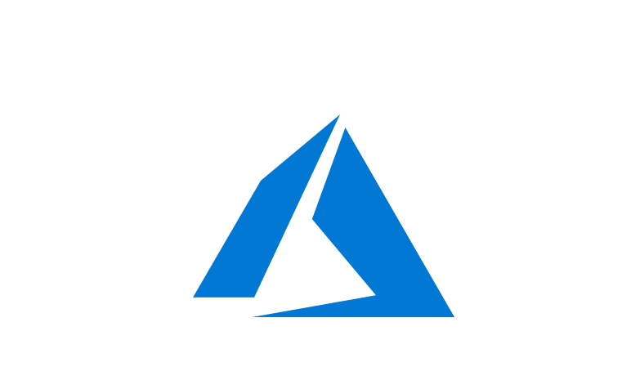
Learning Objectives
You will learn the following concepts:
Overview of Azure Active Directory
Create Management Groups, Subscriptions, and Resource Groups
Users and Groups
Domains and Custom Domains
Azure AD Identity Protection
Implement Conditional Access
Configure Fraud Alerts for MFA
Configure Trusted IPs
Configure Guest Users in Azure AD

Slide 3

Overview of Azure Active Directory

Slide 4
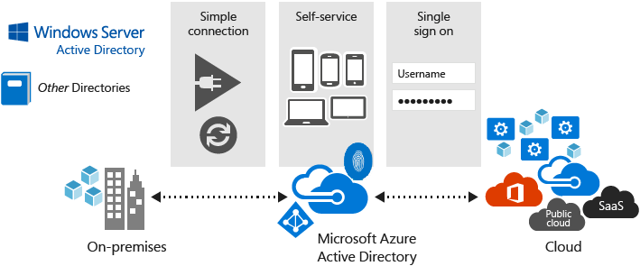
Azure Active Directory (Azure AD)
Multi-tenant cloud-based directory and identity management
Provides single sign-on access to cloud applications and resources
Facilitates developing apps with a global scope
Offers a full suite of identity management capabilities:
Self-service password and group management
Privileged account management
Role-based access control
App usage monitoring
Security monitoring
Device Registration
Alerting
Multi-Factor Authentication (MFA)

Slide 5
Azure AD Concepts
Concept | Description
Identity
Account
Azure AD Account
Azure tenant
Azure AD directory
Azure subscription
An object that can be authenticated.
An identity that has data associated with it.
An identity created through Azure AD or another Microsoft cloud service.
A dedicated and trusted instance of Azure AD that's automatically created when your organization signs up for a Microsoft cloud service subscription.
Each Azure tenant has a dedicated and trusted Azure AD directory.
Used to pay for Azure cloud services.

Slide 6
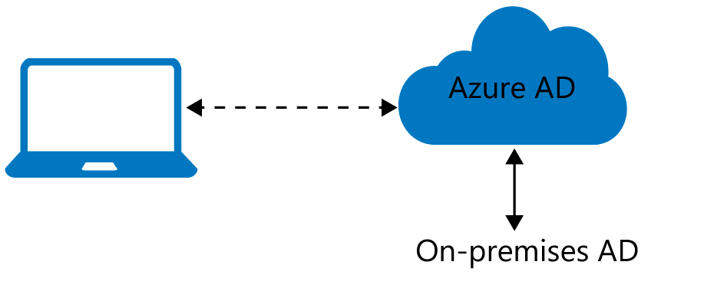
Azure AD Join
Benefits of AD Join:
Single-sign-on (SSO)
Enterprise compliant roaming
Access to Microsoft Store for Business
Windows Hello
Seamless access to on-premises resources
Connection options:
Registering
Joining

Slide 7
Devices in Azure AD
Azure AD registered
Devices that are Azure AD registered are signed in with a personal Microsoft account or another local account.
Windows 10
iOS
Android
MacOS
Azure AD joined
Devices that are Azure AD joined are owned by an organization and are signed in with an Azure AD account belonging to that organization. They exist only in the cloud.
Windows 10
Windows Server 2019 Virtual Machines running in Azure (Server core is not supported)
Hybrid Azure AD joined
Devices that are hybrid Azure AD joined are owned by an organization and are signed in with an Active Directory Domain Services. They exist in the cloud and on-premises.
Windows 7, 8.1, or 10
Windows Server 2008 or newer

Slide 8
Create Management Groups, Subscriptions, and Resource Groups

Slide 9
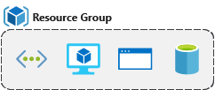
Resource Groups
A resource groups is a fundamental concept of the Azure platform
Serves as a logical grouping of resources
Ties to resource life cycle
Can't be nested
Each resource must belong to a resource group
Most resources can be moved between resource groups

Slide 10
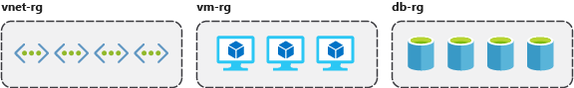
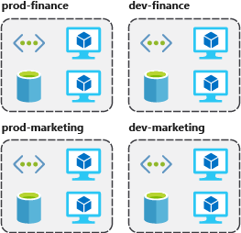
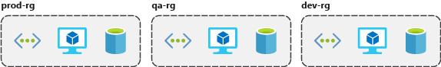
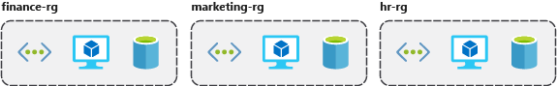
Resource Group Organization (1 of 2)
Consistent naming convention
Organizing principles

Slide 11
Resource Group Organization (2 of 2)
Organizing for authorization
Organizing for life cycle
Organizing for billing

Slide 12
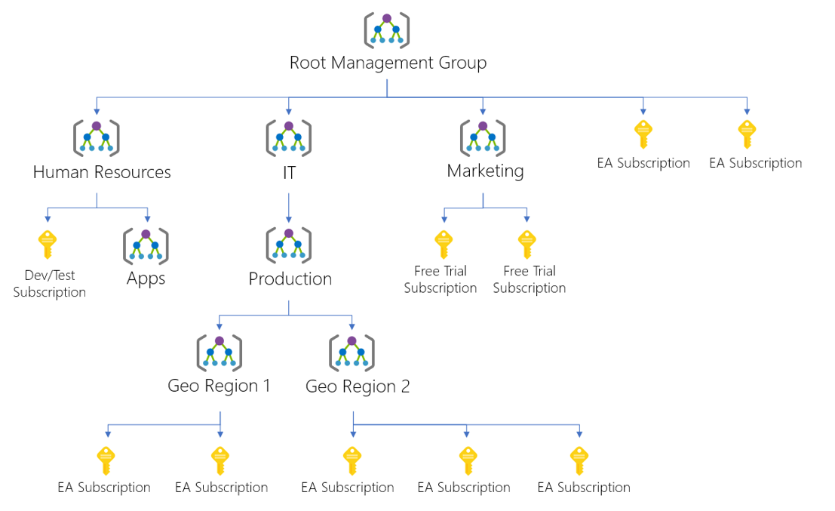
Management Groups
Provides a level of scope above subscriptions
Targeting of policies and spend budgets across subscriptions and inheritance down the hierarchies
Compliance and cost reporting by organization (business/teams)

Slide 13

Subscriptions and Limits (Quotas)
Azure subscription and service limits:
Microsoft Azure limits are also called quotas
Some limits apply on the regional level
Managing limits:
You can raise soft limits by raising an online customer support request at no charge

Slide 14
Subscription and Service General Limits
Management group limits
Subscription limits
Resource group limits
Template limits

Slide 15
Users and Groups

Slide 16
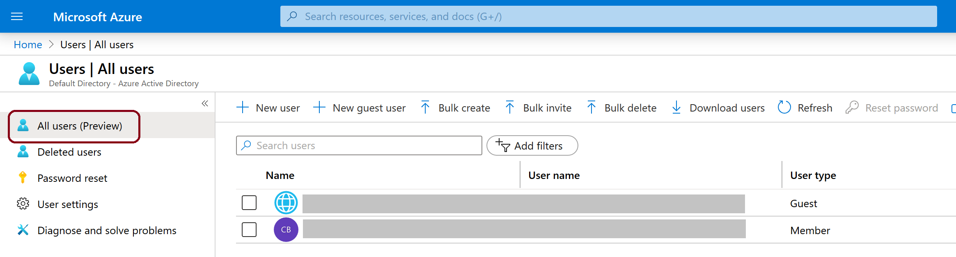
User Accounts
To view the Azure AD users, access the All users blade
Azure AD defines users in three ways:
Cloud identities
Directory-synchronized identities
Guest users

Slide 17
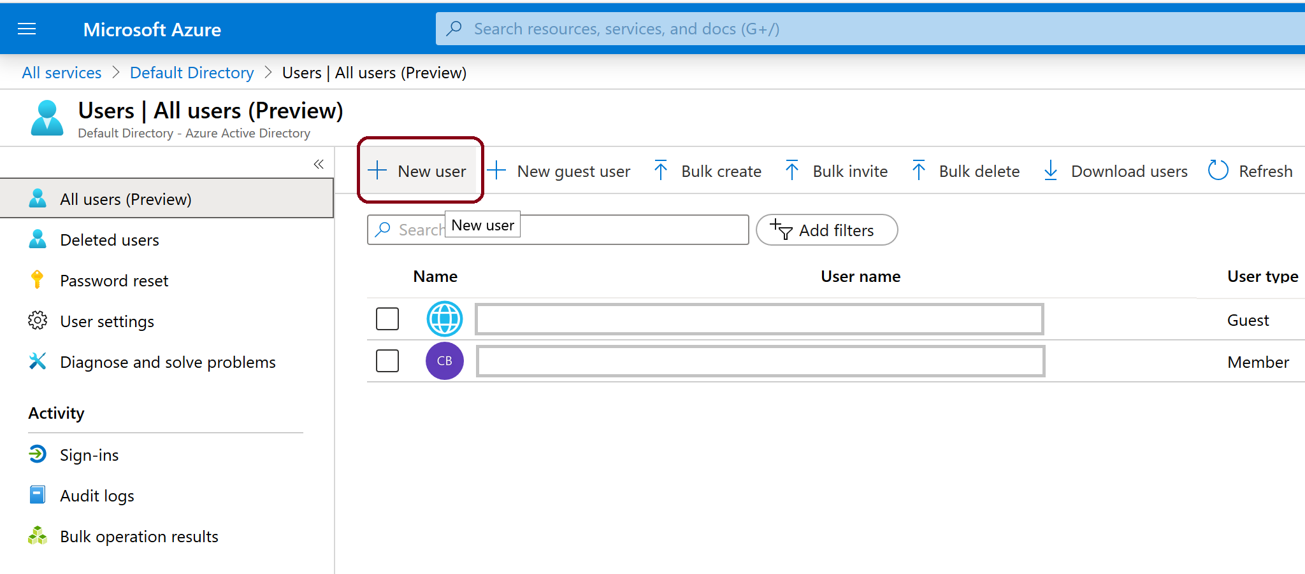
Create and Manage Users (1 of 3)
Adding users:
Synchronizing users from Windows Server Active Directory
Manually creating users by using the Azure portal

Slide 18
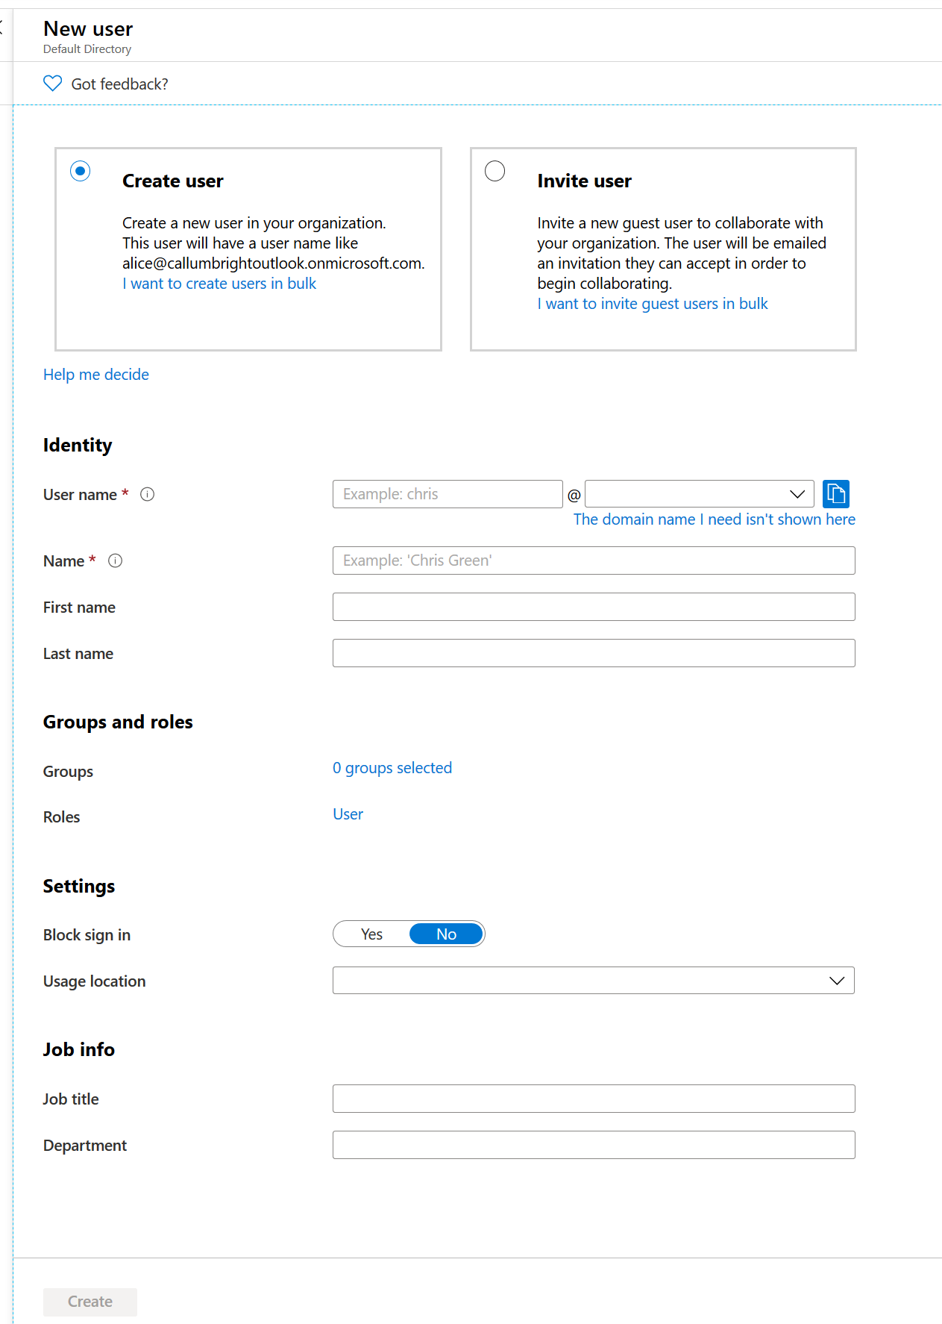
Create and Manage Users (2 of 3)
Creating a User…

Slide 19
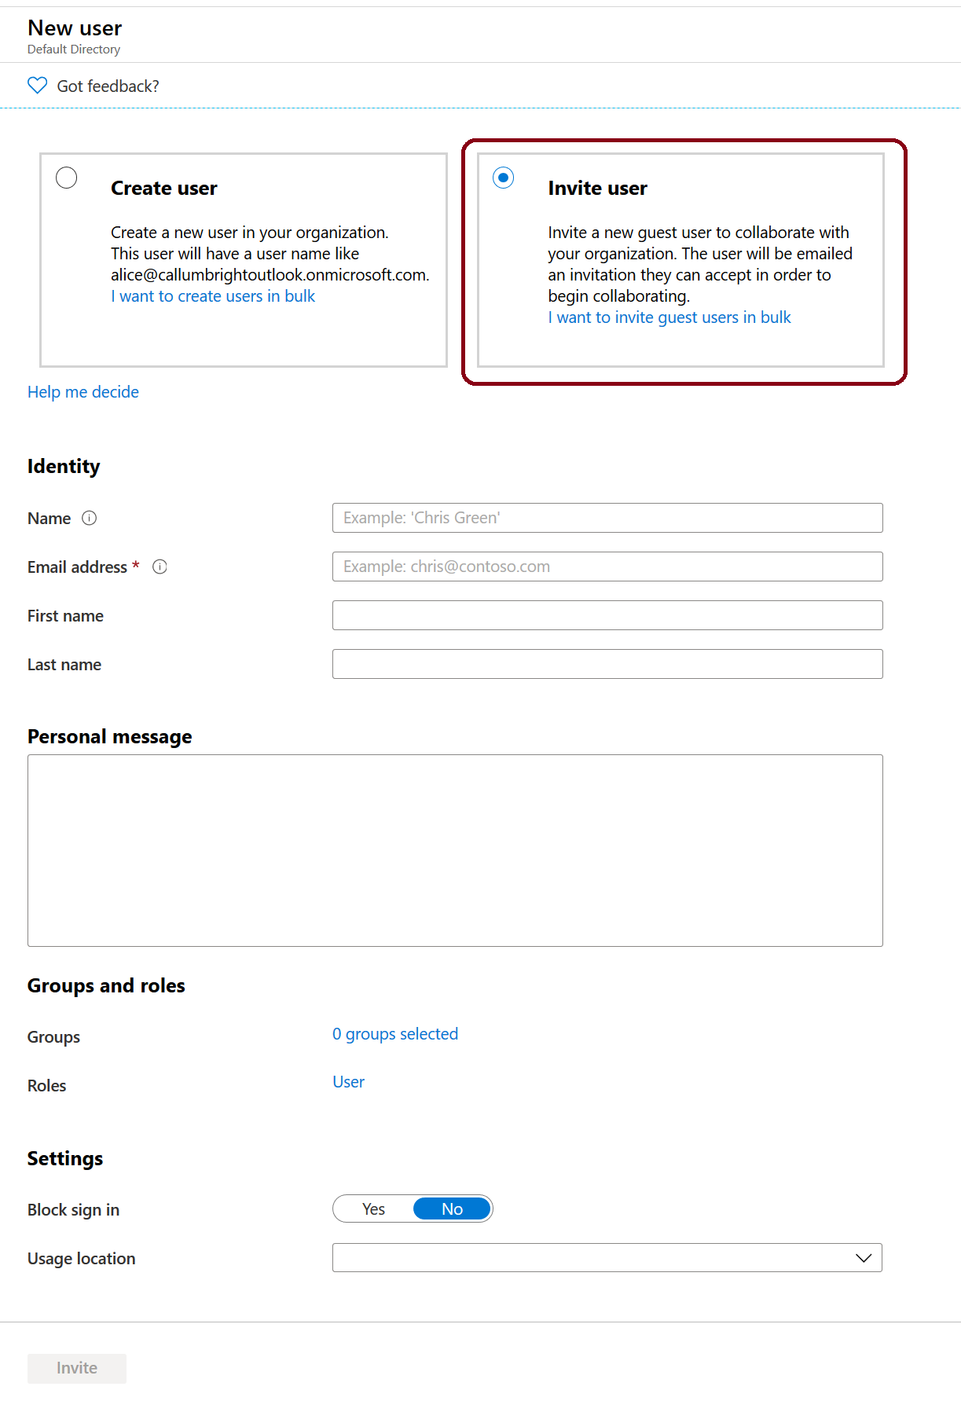
Create and Manage Users (3 of 3)
Inviting a user…

Slide 20
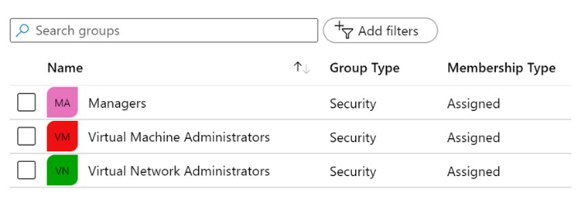
Group Accounts
You can define two different types of groups
Security groups
Office 365 groups
Adding members to groups:
Assigned
Dynamic user
Dynamic device

Slide 21
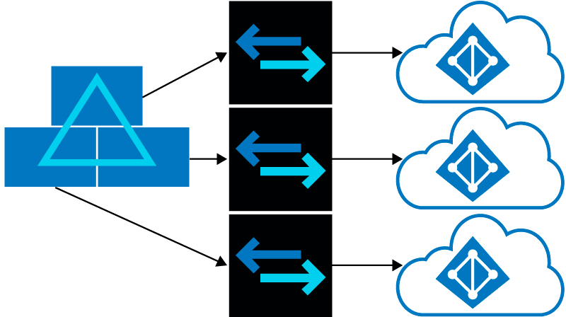
Managing Multiple Directories
Independence between tenants:
Resource independence
Administrative independence
Synchronization independence
You can create multiple Azure AD tenants

Slide 22
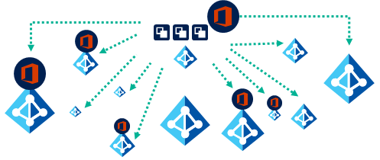
Azure AD B2B and B2C (1 of 2)
With Azure AD B2B:
There is no external administrative overhead for your organization
The partner uses their own identities and credentials; Azure AD is not required
You don't need to manage external accounts or passwords
You don't need to sync accounts or manage account lifecycles

Slide 23
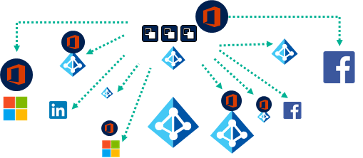
Azure AD B2B and B2C (2 of 2)
With Azure AD B2C:
You invite users from other social media identity providers into your own organization tenant
User provisioning is done by the invited party
Standards-based authentication protocols are used including OpenID Connect, OAuth 2.0, and SAML.
There is integration support for most modern applications and commercial off-the-shelf software
The directory can hold 100 custom attributes per user
Identity verification and proofing can be performed by collecting user data, then passing it to a third party system for validation, trust scoring, and approval for user account creation

Slide 24
Demonstration: Users and Groups
Explore Active Directory users and groups
Explore PowerShell for group management

Slide 25
Domains and Custom Domains

Slide 26
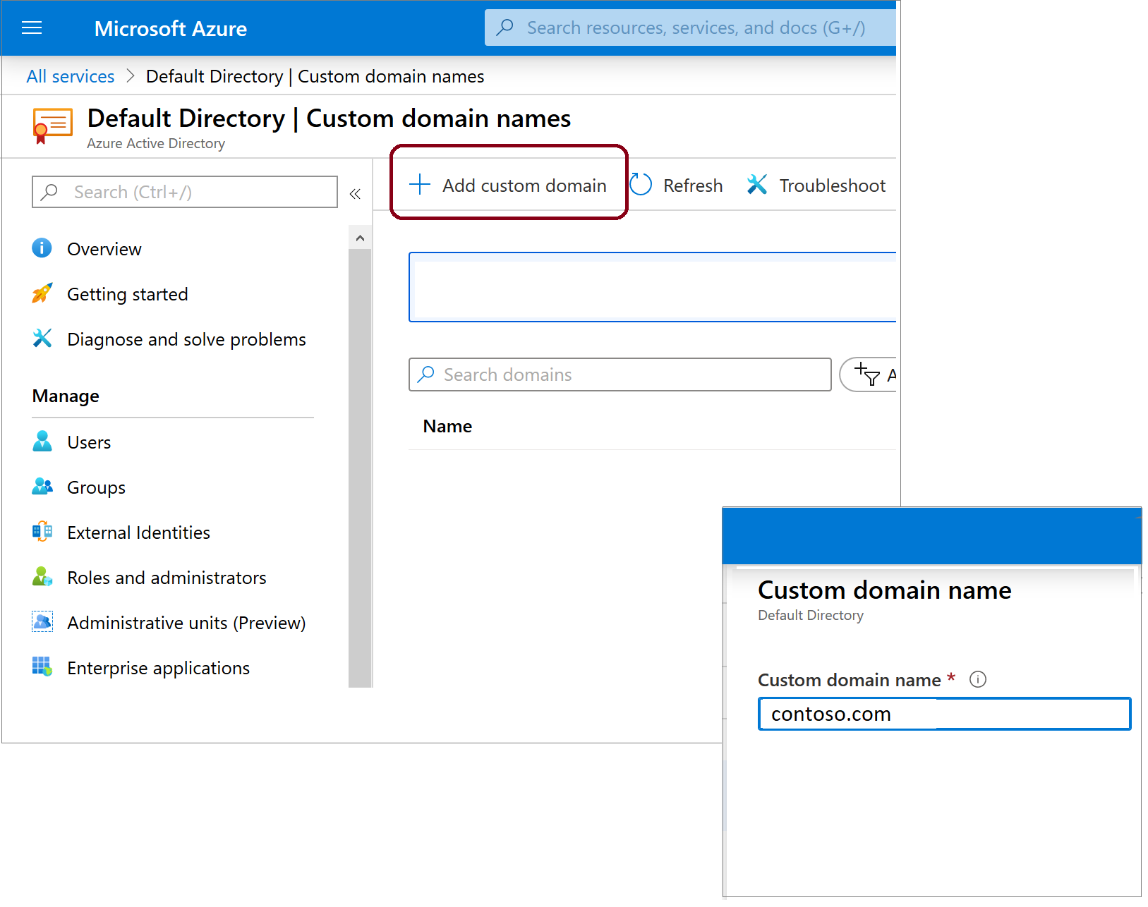
Domains and Custom Domains
Azure AD tenant domain names:
Initial (mandatory) with onmicrosoft.com suffix
Custom (optional)
Domain name management:
Requires global administrator privileges
Domain names are globally unique
Custom domain names require verification

Slide 27
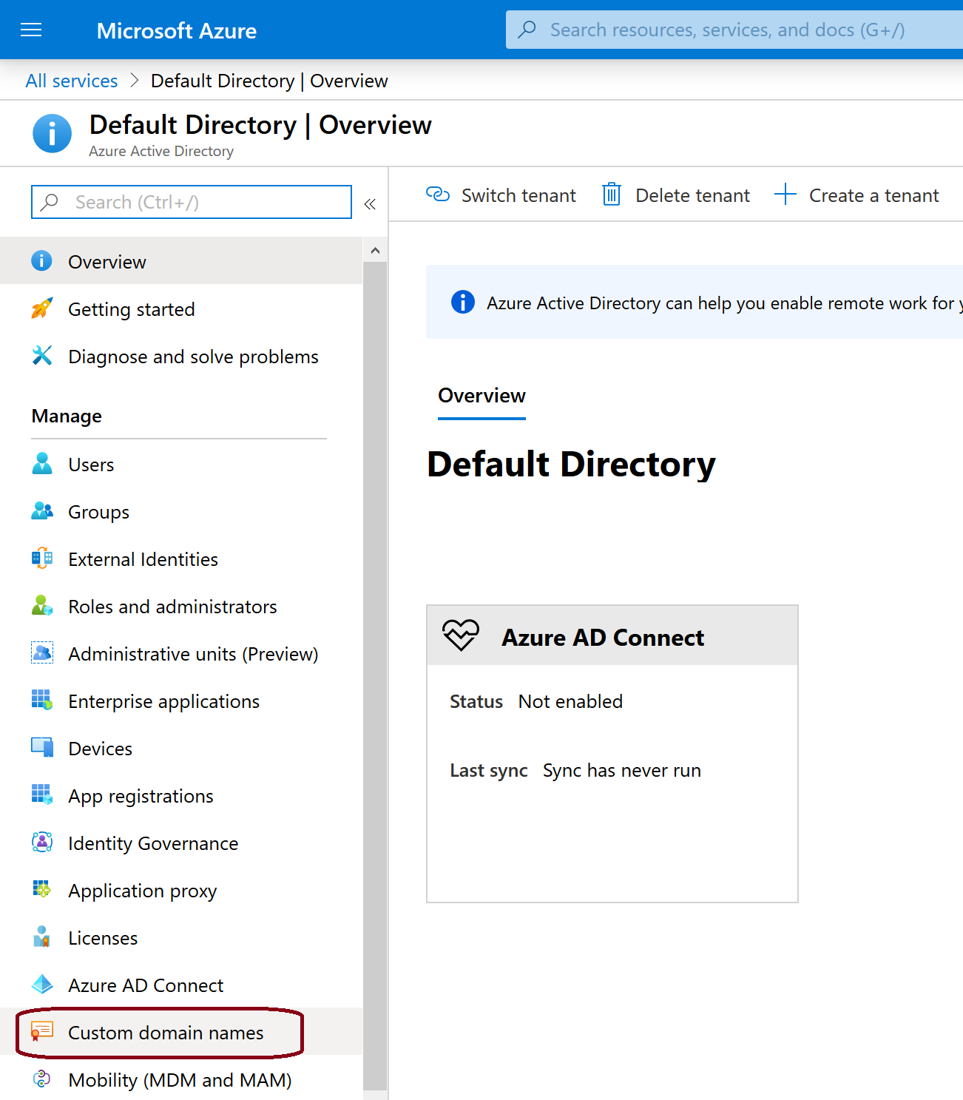
Add a Custom Domain Name to Azure AD
After you create your Azure AD tenant, you can add a custom domain name using Azure portal

Slide 28
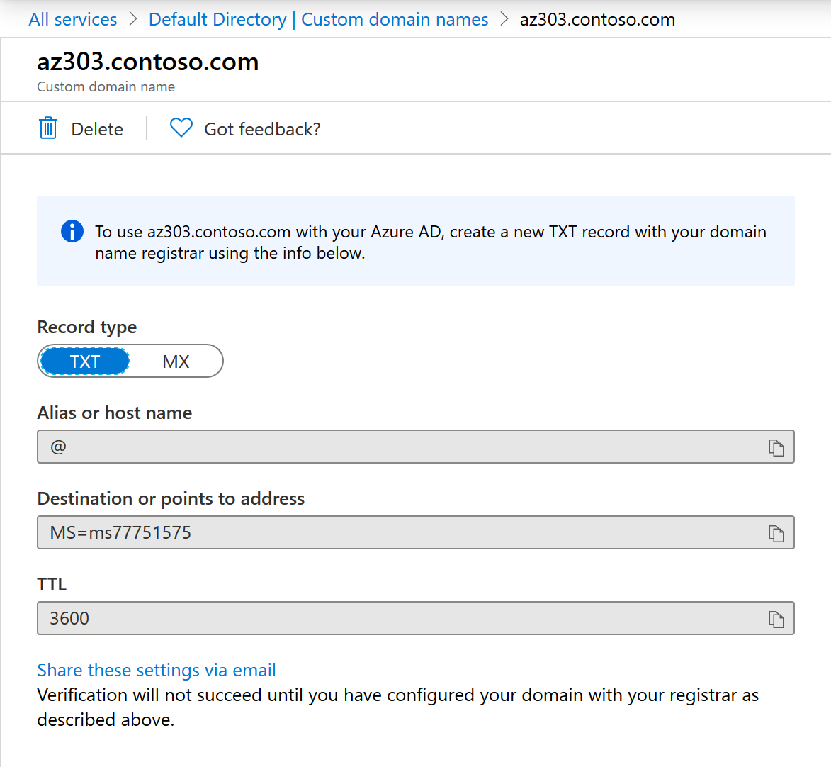
Verifying Custom Domain Names
A custom domain name is initially in an unverified state
To verify a custom domain, you must create a specific TXT or MX DNS record in the corresponding DNS zone

Slide 29
Azure AD Identity Protection

Slide 30

Azure Active Directory Identity Protection (1 of 2)
Protection allows organizations to accomplish three key tasks:
Automate the detection and remediation of identity-based risks
Investigate risks using data presented in the Azure portal
Export risk detection data to third-party utilities for further analysis

Slide 31
Azure Active Directory Identity Protection (2 of 2)
Risk detection and remediation
Risk investigation
Risky users, risky sign-ins, risk detections
Risk detection type | Description
Atypical travel | Sign in from an atypical location based on the user's recent sign-ins.
Anonymous IP address | Sign in from an anonymous IP address (for example: Tor browser, anonymizer VPNs).
Unfamiliar sign-in properties | Sign in with properties we've not seen recently for the given user.
Malware linked IP address | Sign in from a malware linked IP address
Leaked Credentials | This risk detection indicates that the user's valid credentials have been leaked
Azure AD threat intelligence | Microsoft's internal and external threat intelligence sources have identified a known attack pattern

Slide 32
Implement Conditional Access

Slide 33
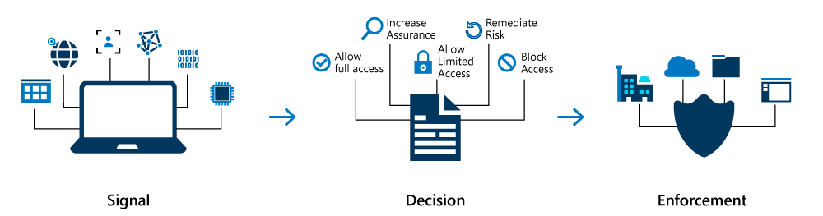
Overview of Conditional Access
Administrators have two primary goals:
To empower users to be productive wherever and whenever.
To protect the organization's assets.
Conditional Access policies at their simplest are if-then statements—If a user wants to access a resource, then they must complete a particular action first.
Conditional Access allows you to apply the right access controls when needed to keep your organization secure and stay out of your user’s way when not needed.

Slide 34
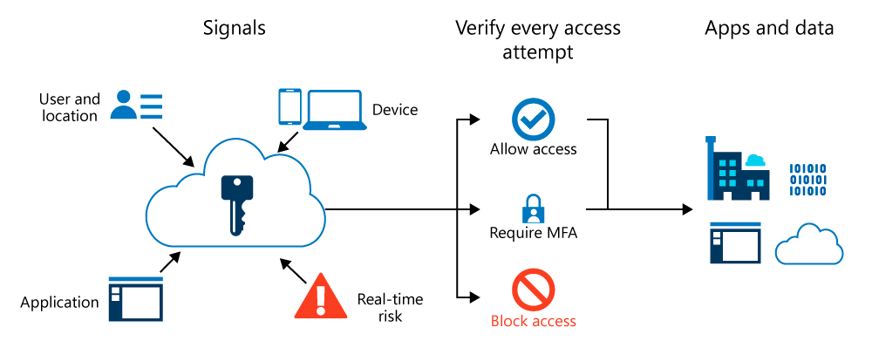
Conditional Access and Azure Multi-Factor Authentication
Provides two step authentication verification
Lets you enforce controls on access to apps based on specific conditions:
Users and groups can be enabled for MFA to prompt for additional verification during sign-in.
Alternatively, Conditional Access policies can be used to define events or applications that require MFA.

Slide 35

Conditional Access – Signals and Decisions (1 of 2)
Common signals:
User or group membership
IP location information
Device
Application
Real-time and calculated risk detection
Microsoft Cloud App Security (MCAS)
Common decisions:
Block access
Grant access

Slide 36
Conditional Access – Signals and Decisions (2 of 2)
Common applied policies:
Requiring multi-factor authentication for users with administrative roles
Requiring multi-factor authentication for Azure management tasks
Blocking sign-ins for users attempting to use legacy authentication protocols
Requiring trusted locations for Azure Multi-Factor Authentication registration
Blocking or granting access from specific locations
Blocking risky sign-in behaviors
Requiring organization-managed devices for specific applications

Slide 37
Demonstration: Conditional Access Azure MFA
Create a conditional access policy
Configure conditions for multifactor authentication
Test Azure multifactor authentication

Slide 38
Configure Multi-Factor Authentication

Slide 39
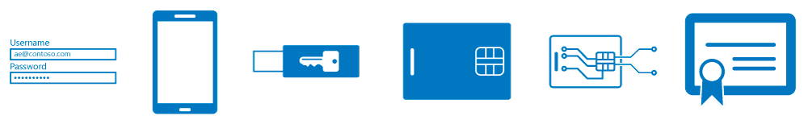
Multi-Factor Authentication (1 of 2)
Azure Multifactor Authentication (MFA) methods:
Something you know, typically a password
Something you have, such as a trusted device that is not easily duplicated, like a phone or hardware key
Something you are - biometrics like a fingerprint or face scan

Slide 40
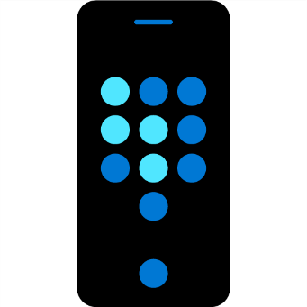
Multi-Factor Authentication (2 of 2)
Available verification methods:
Microsoft Authenticator app
OATH hardware token
SMS
Authentication methods:
Call to phone
Text message to phone
Notification through mobile app
Verification code from mobile app

Slide 41
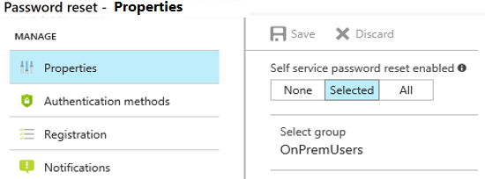
Self-Service Password Reset (1 of 2)
Enabling Self-Service Password Reset (SSPR) gives the users the ability to bypass the helpdesk and reset their own passwords
Three options of Password reset properties:
None
Selected
All

Slide 42
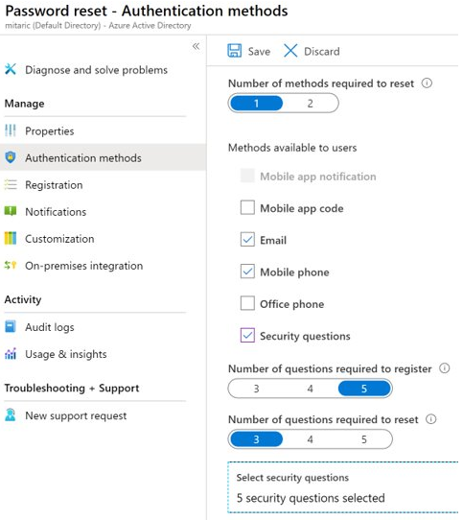
Self-Service Password Reset (2 of 2)
SSPR Authentication methods:
Mobile app code
Email
Mobile phone
Office phone
Security questions

Slide 43
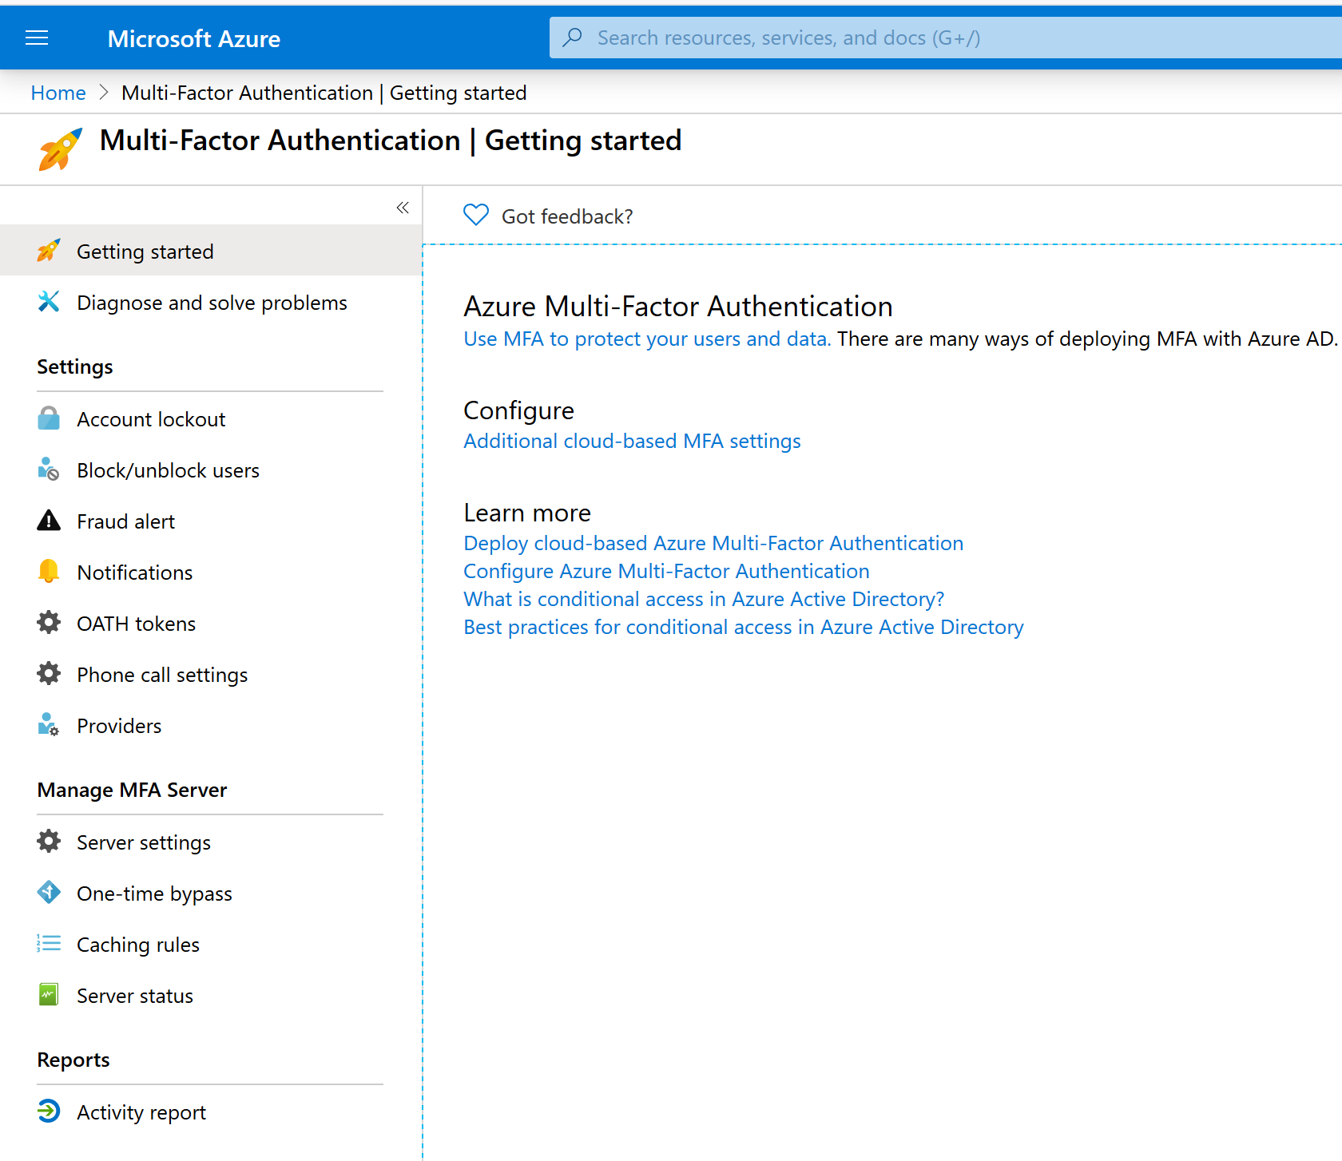
Configure Azure MFA Settings (1 of 2)
Settings (via the Azure portal):
Access the Azure MFA settings by browsing to the Azure AD blade
Select Security
Select MFA
Configure Settings

Slide 44
Configure Azure MFA Settings (2 of 2)
Feature | Description
Account lockout | Temporarily lock accounts in the multi-factor authentication service if there are too many denied authentication attempts in a row. This feature only applies to users who enter a PIN to authenticate.
Block/unblock users | Used to block specific users from being able to receive Multi-Factor Authentication requests. Any authentication attempts for blocked users are automatically denied. Users remain blocked for 90 days from the time that they are blocked.
Fraud alert | Configure settings related to users ability to report fraudulent verification requests
Notifications | Enable notifications of events from MFA Server.
OATH tokens | Used in cloud-based Azure MFA environments to manage OATH tokens for users.
Phone call settings | Configure settings related to phone calls and greetings for cloud and on-premises environments.
Providers | This will show any existing authentication providers that you may have associated with your account.

Slide 45
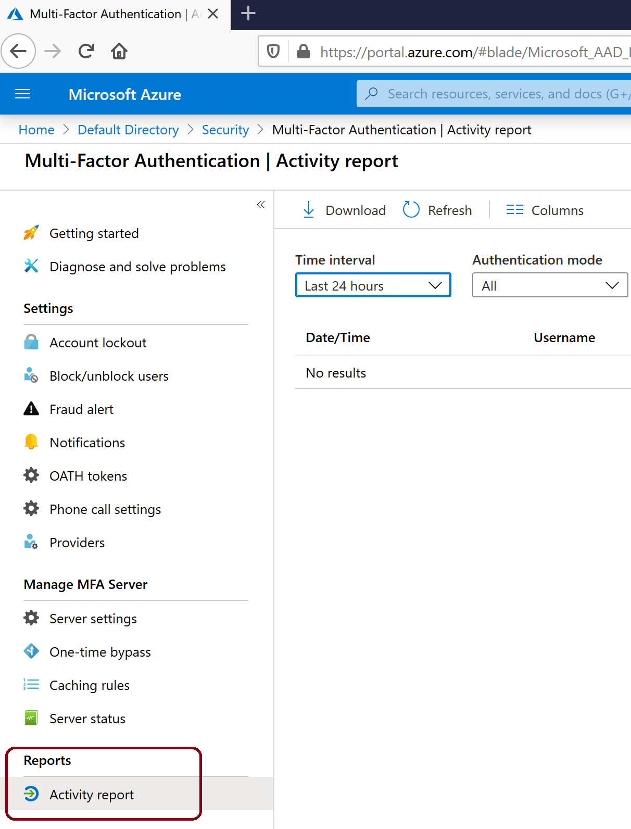
Reports for Azure Multi-Factor Authentication (1 of 2)
Azure MFA provides reports available in the Azure portal
View the MFA reports
Azure AD Sign-ins Report
Was the sign-in challenged with MFA?
How did the user complete MFA?
Why was the user unable to complete MFA?
How many users are challenged for MFA?
How many users are unable to complete the MFA challenge?
What are the common MFA issues end users are running into?

Slide 46
Reports for Azure Multi-Factor Authentication (2 of 2)
Report | Location | Description
Blocked User History | Azure AD > Security > MFA > Block/unblock users | Shows the history of requests to block or unblock users.
Usage and fraud alerts | Azure AD > Sign-ins | Provides information on overall usage, user summary, and user details; as well as a history of fraud alerts submitted during the date range specified.
Usage for on-premises components | Azure AD > Security > MFA > Activity Report | Provides information on overall usage for MFA through the NPS extension, ADFS, and MFA server.
Bypassed User History | Azure AD > Security > MFA > One-time bypass | Provides a history of requests to bypass Multi-Factor Authentication for a user.
Server status | Azure AD > Security > MFA > Server status | Displays the status of Multi-Factor Authentication Servers associated with your account.

Slide 47
Configure Trusted IPs

Slide 48
Azure AD Conditional Access Location Condition
Azure AD enables single sign-on to devices, apps, and services from anywhere on the public internet.
With the location condition of a Conditional Access policy, you can control access to your cloud apps based on the network location of a user.
Common use cases for the location condition are:
Requiring multi-factor authentication for users accessing a service when they are off the corporate network.
Blocking access for users accessing a service from specific countries or regions.
Note: A location is a label for a network location that either represents a named location or multi-factor authentication Trusted IPs.

Slide 49
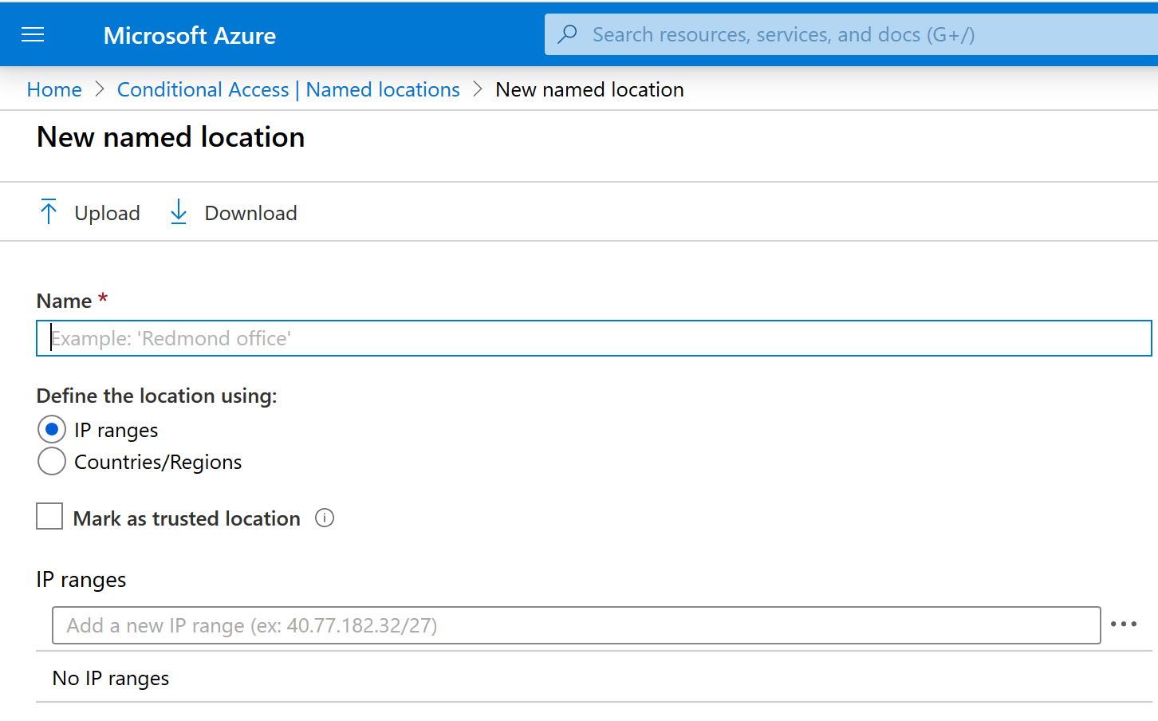
Named Locations
Create logical groupings of IP address ranges or countries and regions
Use groupings in the location condition of Conditional Access policies
A named location has the following components:
Name
IP ranges
Mark as trusted location
Countries/regions
Include unknown areas

Slide 50

Trusted IPs
You can also configure IP address ranges representing your organization's local intranet in the multi-factor authentication service settings.
This feature enables you to configure up to 50 IP address ranges.
The IP address ranges are in CIDR format.
If you have Trusted IPs configured, they show up as MFA Trusted IPs in the list of locations for the location condition.

Slide 51
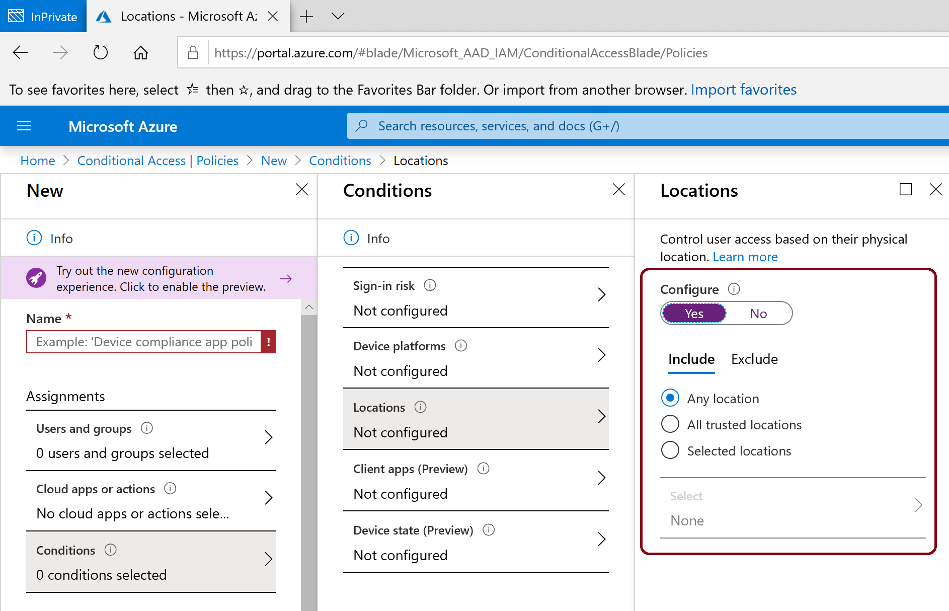
Location Condition Configuration
When you configure the location condition, you have the option to distinguish between:
Any location
All trusted locations
Selected locations

Slide 52
Configure Guest Users in Azure AD

Slide 53

Prerequisites for Guest Users in Azure AD
You can invite anyone to collaborate with your organization by adding them to your directory as a guest user.
Guest users can sign in with their own work, school, or social identities.
To test guest-related scenarios, you need
An Azure AD user with a role that allows creating user accounts
A valid email account

Slide 54
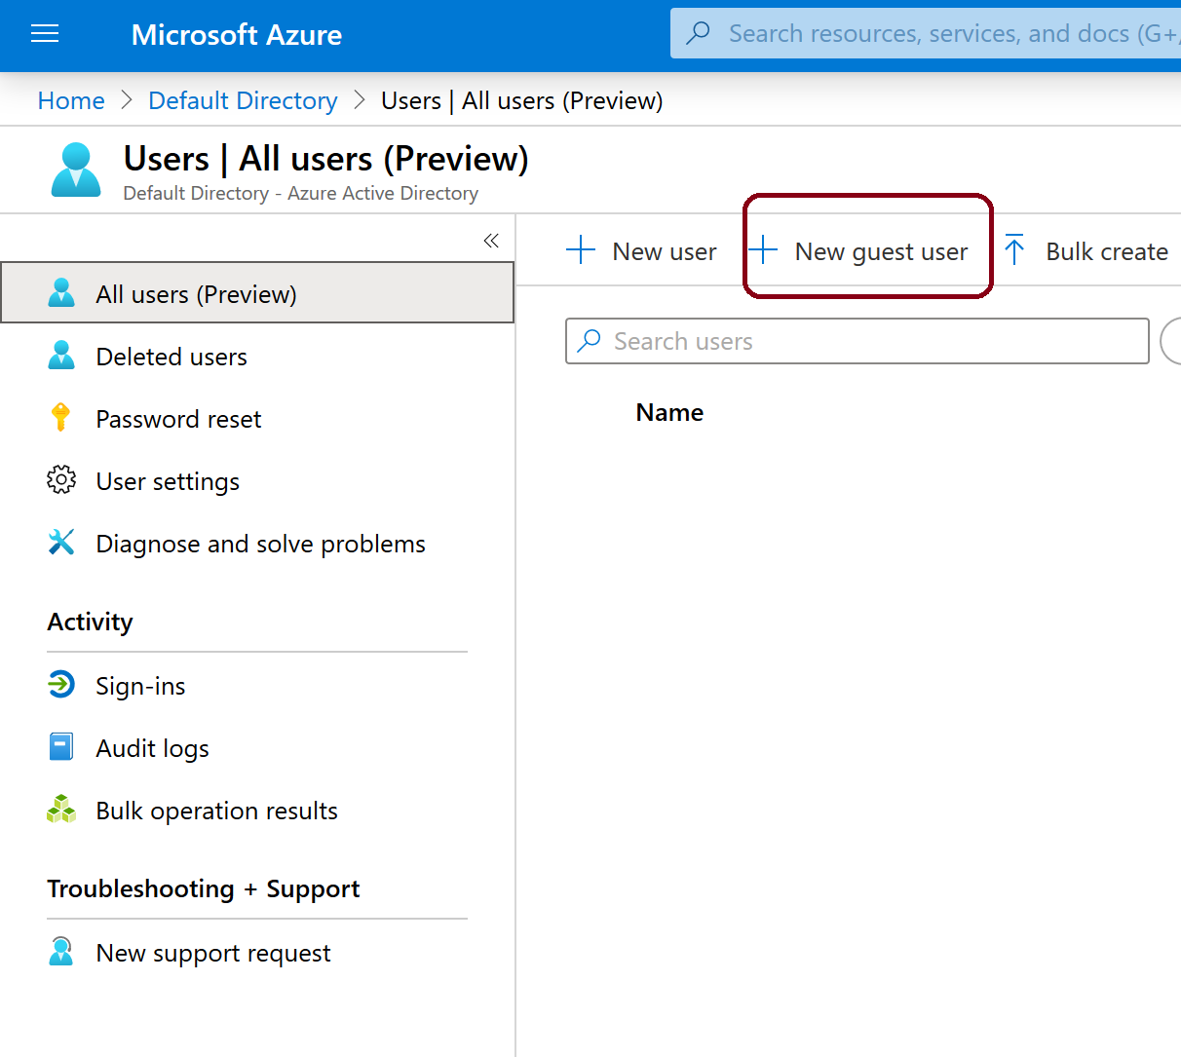
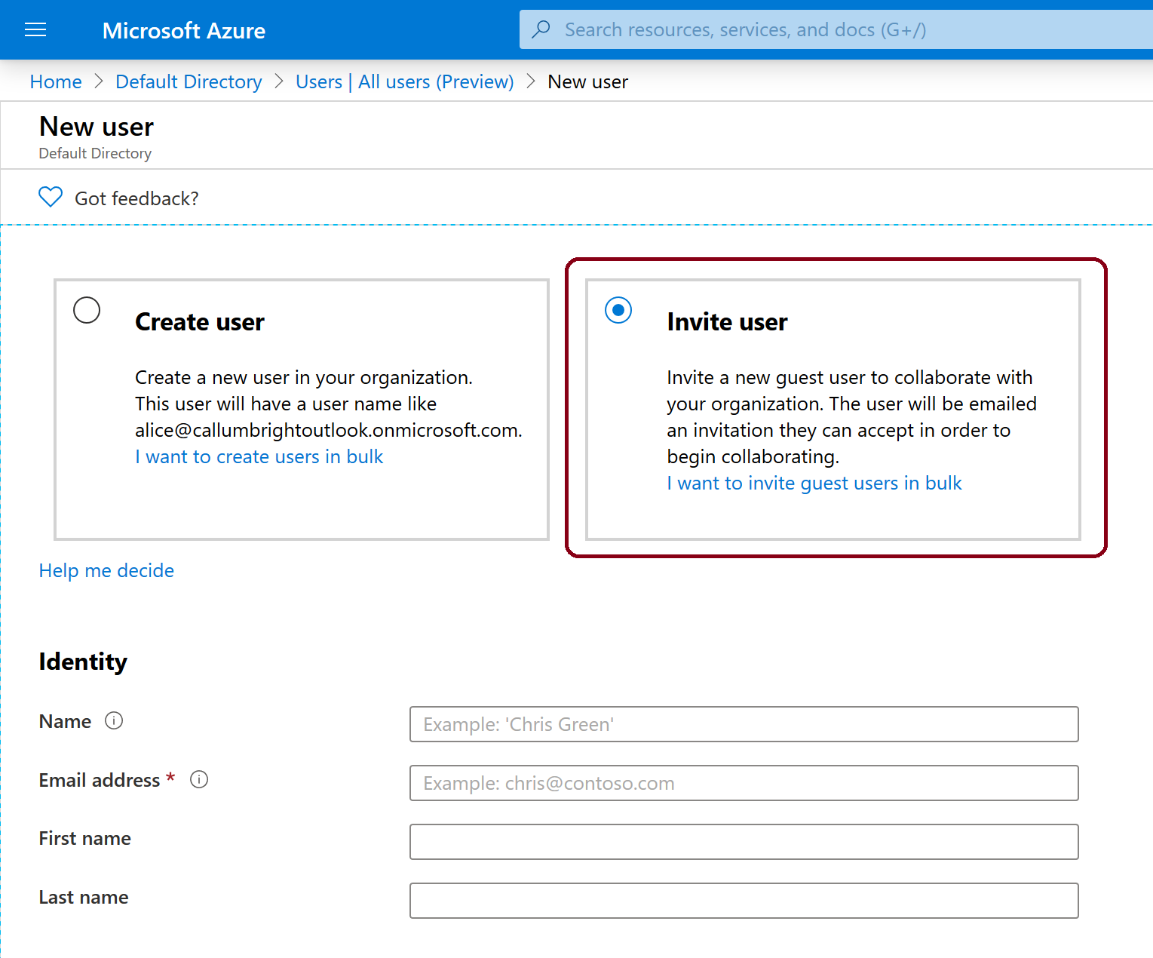
Add Guest Users to Azure AD
Sign into Azure portal and add a guest user

Slide 55
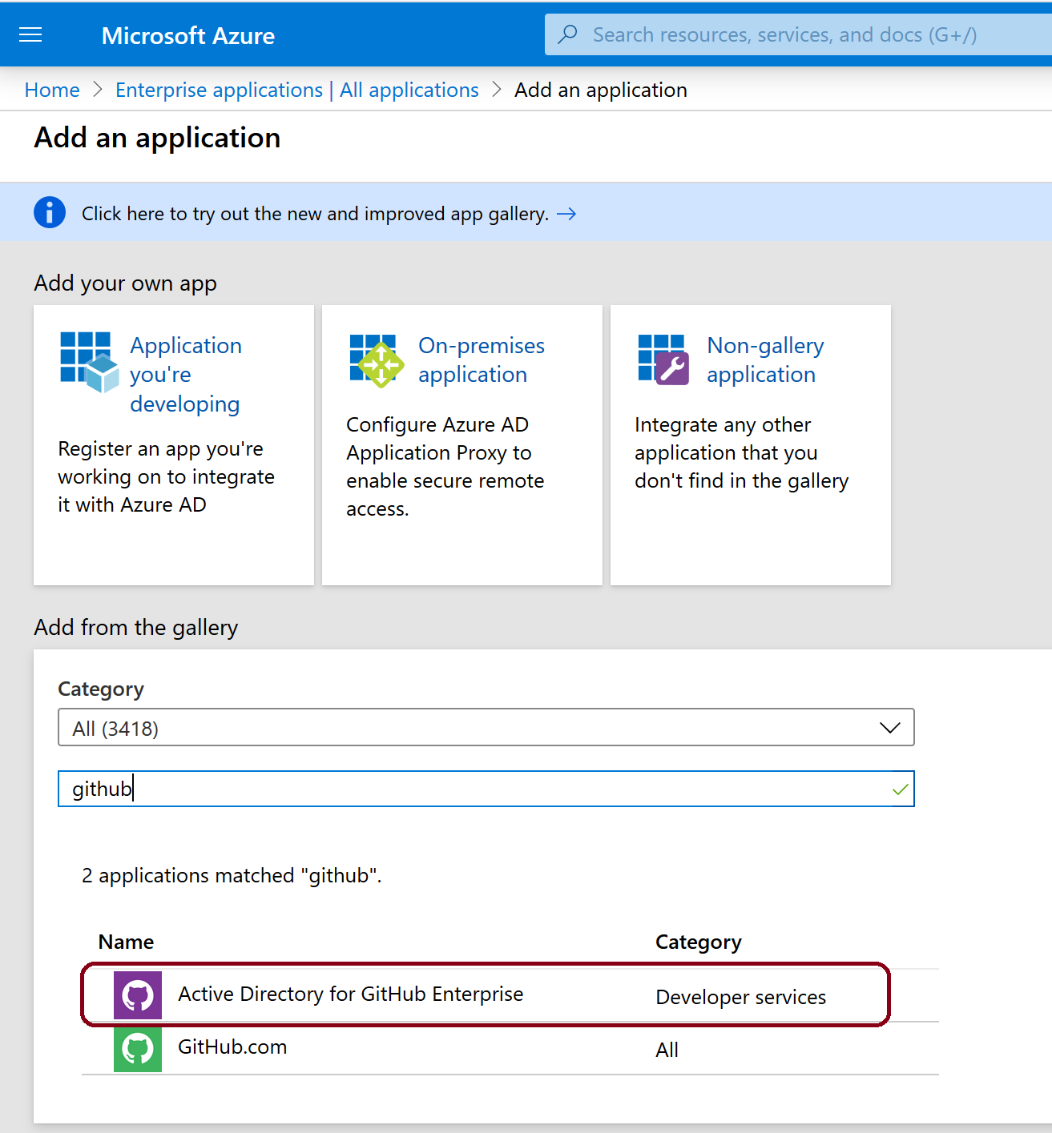
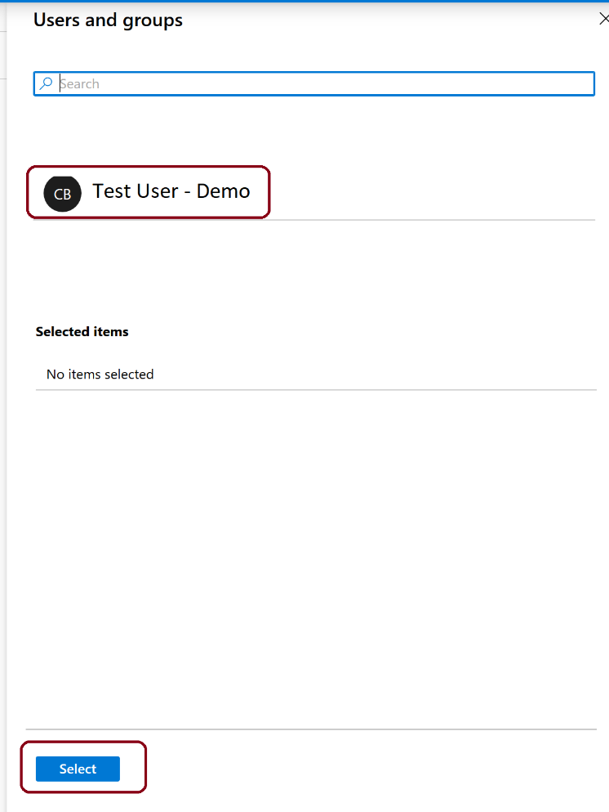
Assign an App to a Guest User
Add the Active Directory for GitHub Enterprise app to your test tenant and assign the test guest user to the app.

Slide 56
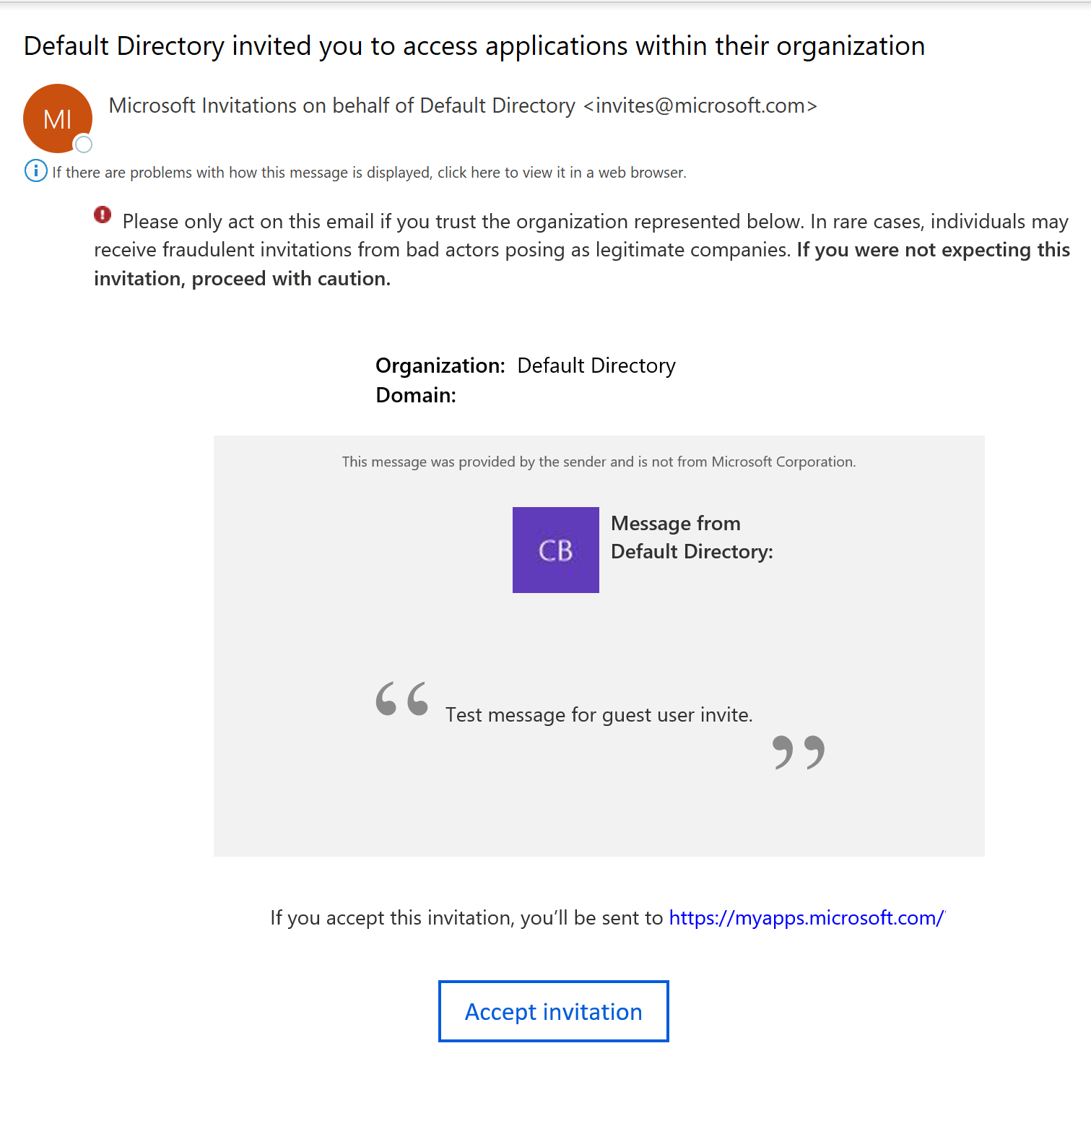
Accept the Guest User Invite
Sign-in to your test guest user's email account
In the inbox, locate the "You're invited" email
In the email body, select Get Started
Select Accept Invitation

